Slide 1
4 Decision (Selection) Structures, Turtle Module and Debugger
Instructor: Raed Karim
Email: raed.karim@sheridancollege.ca
Course: PROG12583

Slide 2
Decision Structures
Objectives
At the end of this module, students will be able to:
Write pseudocode for Decision structures to plan for programming.
Define and analyze the three types of Decision structures:
Single alternative Decision Structures.
Dual alternatives Decision Structures.
Multiple alternatives Decision Structures.
Analyze and implement Turtle module to help solve decision problems.
Run and debug program using debugger and othre testing and debugging techniques.

Slide 3
Writing Pseudocode for Decision Structures Part - 1

Slide 4
Decision Structures
Introduction to Decision Structures
A decision structure (or selection structure) allows a program to perform actions only under certain conditions.
An if statement lets you control the execution of statements based on the results of a Boolean expression.
Different types of decisions include:
If, also called single alternative
If then else, also called dual alternative
If, else if then else structure for multiple alternative decisions

Slide 5
Decision Structures
Designing a program
Before we delve into and work with decision structure, let’s understand how a program should be designed in order to implement it (code it).
Two steps in designing a program:
Understand the tasks that the program is to perform.
Learning what the customer wants.
Determine the steps that must be taken to perform the task.
Create an algorithm, or step-by-step directions to solve the problem.
Use flow charts and/or pseudocode to solve.

Slide 6
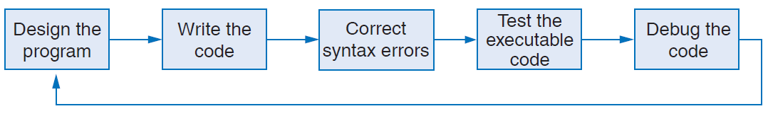
Decision Structures
Designing a program
We use Pseudocode and/or Flowcharts to help design programs.
The design is the foundation of a good program- a program that works and produces expected results.
The program development cycle

Slide 7
Decision Structures
Designing a program
Pseudocode is fake code used as a model for programs.
No syntax rules
Well written pseudocode can be easily translated to actual code (e.g., python).
An example of a pseudocode that allows a user to enter the values of hours worked and a pay rate for an employee, then the gross pay value is calculated (the fifth step); last, the output is displayed.
Display "Enter the number of hours"
Input hours
Display "Enter the hourly pay rate"
Input payRate
Set grossPay = hours * payRate
Display "The gross pay is $", grossPay

Slide 8
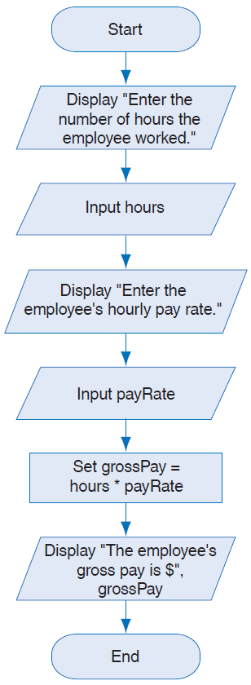
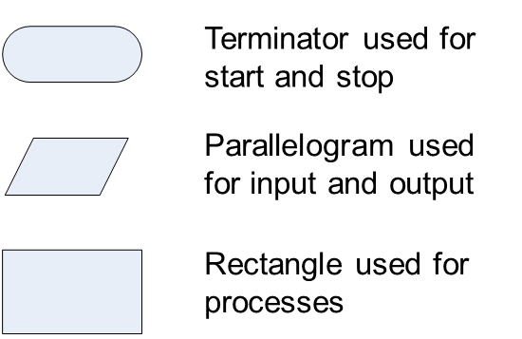
Decision Structures
Designing a program
Flowchart is a diagram that graphically depicts the steps that take place in a program.
Flow chart for the pay calculating program

Slide 9
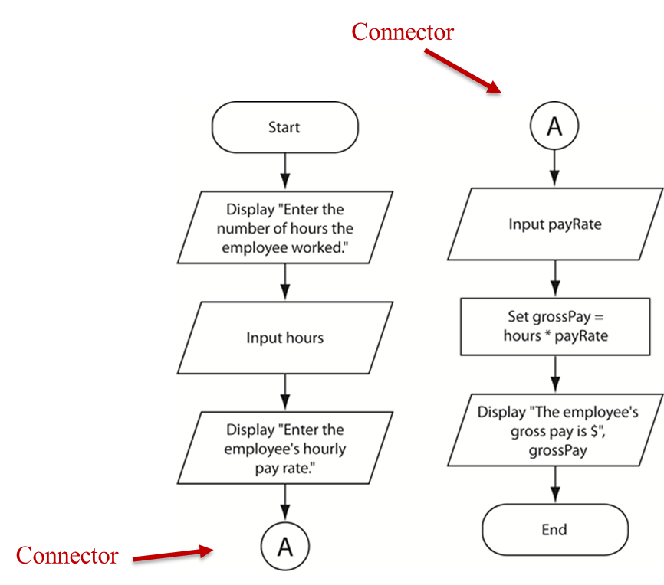
Decision Structures
Designing a program
Flow chart Connector Symbol
Use connectors to break a flow chart into two or more smaller flow charts and placing them side-by-side on the page.

Slide 10
Decision Structures
Designing a program
Calculate the batting average for any player
Determine what is required for each phase of the program:
What must be read as input?
What will be done with the input?
What will be the output?

Slide 11
Decision Structures
Designing a program
Input is received.
The number of hits
The number of times at bat
Some process is performed on the input.
Calculate the batting average
Divide the number of hits by the number of times at bat
Output is produced.
The player’s batting average

Slide 12
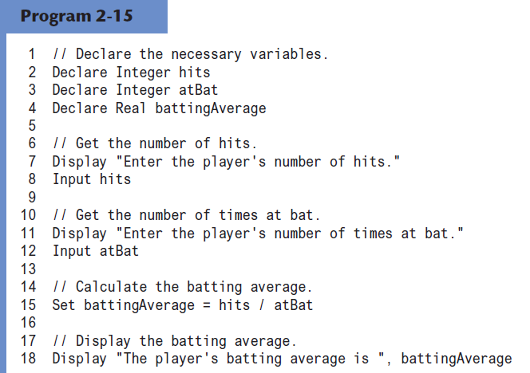
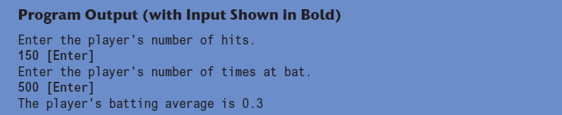
Decision Structures
Designing a program

Slide 13
Decision Structures
Designing a program
The benefit of the pseudocode is that you can plan the logic without worrying about coding details like parentheses, quotation marks, and colons. As a result, you can document the logic more quickly and experiment with multiple approaches before you decide on the best one and use it as your guide to the Python coding.
In practice, you often write out your pseudocode by hand. Because you’re the only one who is going to use it, it doesn’t need to be neat or formal. Then, after you’ve coded and tested the Python code, you usually throw away the pseudocode.

Slide 14
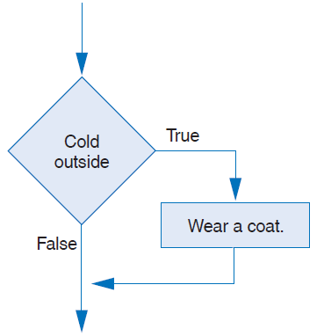
Decision Structures
Intro to Decision Structure: a single alternative structure
The if statement:
An action only occurs (pseudocode of a single If statement)
A single alt. decision structure for an everyday task
If condition Then
statement
statement
End If

Slide 15
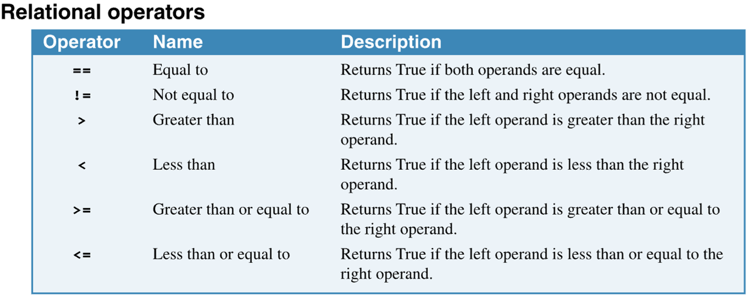
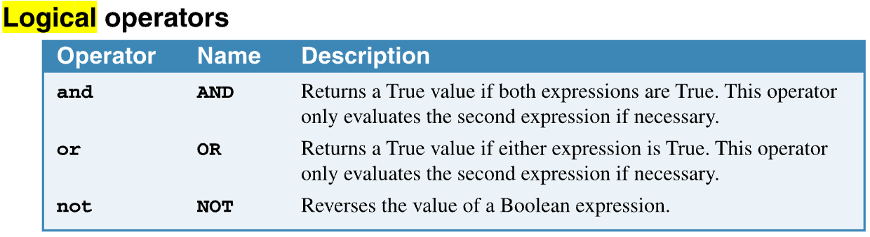
Decision Structures
Relational Operators:
Determines whether a specific relationship exists between two values
Used within the condition, a Boolean expression
A single alt. decision structure for an everyday task
Intro to Decision Structure: a single alternative structure

Slide 16
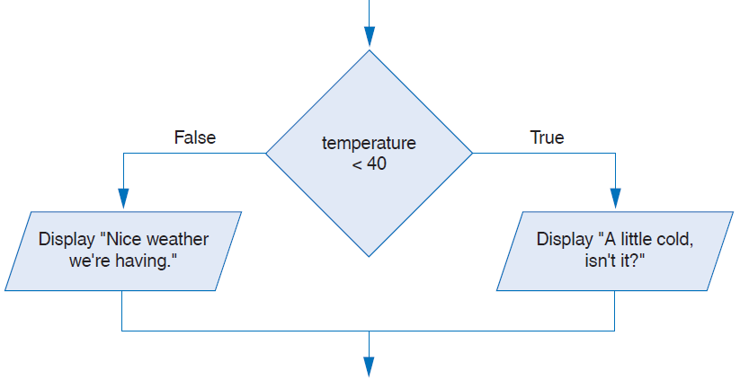
Decision Structures
Intro to Decision Structure: dual alternative structure
If then else statement
Executes one group of statements if it’s Boolean expression is true, or another group if its Boolean expression is false
A dual alternative decision structure

Slide 17
Decision Structures
Intro to Decision Structure: dual alternative structure
If condition Then
statement
statement
Else
statement
statement
End If
If temperature < 40 Then
Display "A little cold"
Display "Get a coat!"
Else
Display "Nice weather"
Display "And sunny!"
End If
The If statement checks for the temperature if it’s less than 40. If it evaluates the condition to Ture, then two Display statements are executed:
Display "A little cold"
Display "Get a coat!"
However, if it evaluates the condition to False the Else clause is executed and the two Display statements are executed:
Display "Nice weather"
Display "And sunny!"

Slide 18
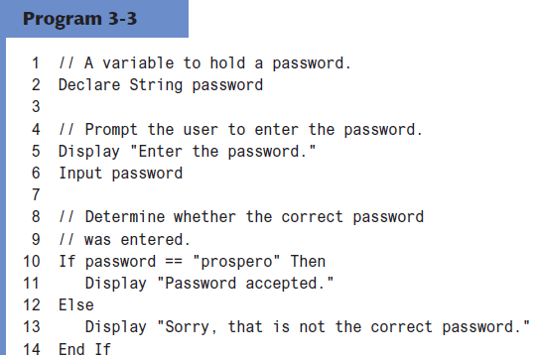
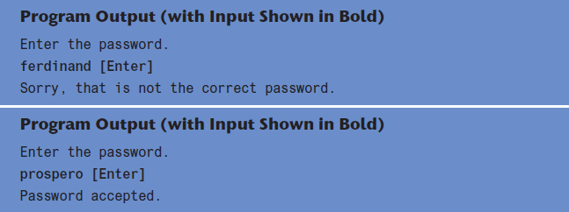
Decision Structures
Intro to Decision Structure: dual alternative structure
Indentation in the if-else Statement
When you write an statement, follow these guidelines for indentation:
Make sure the if clause and the else clause are aligned.
The if clause and the else clause are each followed by a block of statements.
Make sure the statements in the blocks are consistently indented.
Pseudocode to compare two strings

Slide 19
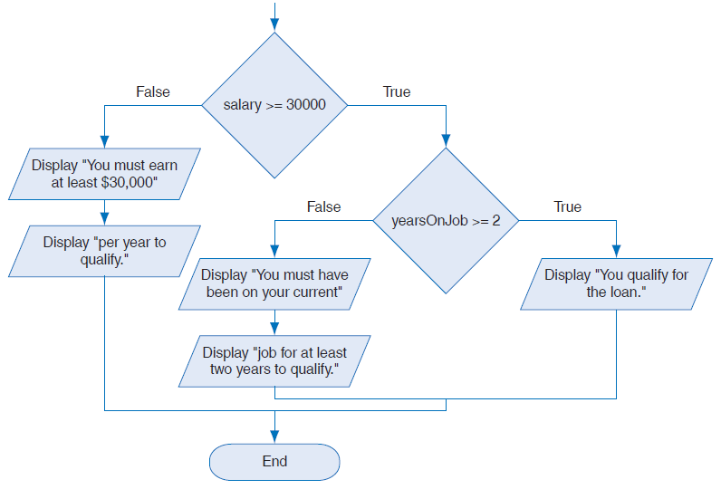
Decision Structures
Intro to Decision Structure: multiple alternative structure
Decisions are nested in order to test more than one condition
If salary >=3000 Then
if yearsOnJob >= 2 Then
Display " You qualify for the loan. "
Else
Display " You must have been on your current job for at least two years to qualify. "
Else
Display " You must earn at least $3000 per year to qualify. "
End If
A nested decision structure

Slide 20
Decision Structures
Intro to Decision Structure: multiple alternative structure
Decisions are nested in order to test more than one condition
If salary >=3000 Then
if yearsOnJob >= 2 Then
Display " You qualify for the loan. "
Else
Display " You must have been on your current job for at least two years to qualify. "
Else
Display " You must earn at least $3000 per year to qualify. "
End If
A nested decision structure

Slide 21
Decision Structures
Intro to Decision Structure: multiple alternative structure
How the nested if structure works in the previous slide?
The outer if checks for the salary if greater or equal to $3000. If the condition is evaluated to True the inner if clause is executed; otherwise, the Else clause is executed and the message " You must earn at least $3000 per year to qualify. “ is displayed.
Inside the outer if the condition (yearsOnJob >= 2) is evaluated to True, the Display " You qualify for the loan. " is executed; otherwise, Display " You must have been on your current job for at least two years to qualify. “ is executed.

Slide 22
Decision Structures
Intro to Decision Structure: multiple alternative structure
In this example, after getting the value of score from the user, the if clause checks for the score value. If (score < 60) is evaluated to True, the Display "Grade is F. " is executed, and the interpreter exists the entire if structure, and continues in the program after the if structure. However, if the condition is evaluated to False, the Else If is evaluated, and the process continues in the same way.
In a single run, only one clause in the if structure is executed depends on how the condition gets evaluated.
Another way to implement the multiple alternative decision structure.
Read score
If score < 60 Then
Display "Grade is F."
Else If score < 70 Then
Display "Grade is D."
Else If score < 80 Then
Display "Grade is C."
Else If score < 90 Then
Display "Grade is B."
Else
Display "Grade is A."
End If

Slide 23
Decision Structures
Pseudocode Exercise: Do it yourself !
Design a program that solves the following problem: Hint: if someone asks you to design a program, the first thing should come to your mind is NOT to code because design happens before coding. To design you write a pseudocode and/or draw a flowchart.
The user enters a customer type (‘r’ , or ‘w’) and the total of purchases.
The program checks for the customer type (‘r’), if evaluated to True, it checks for the total. If the total > 0 and < $100, the discount percent is 0.1; if total >= $100 and < $250, the discount percent is 0.2; if the total >= $250 and < $500, the discount percent is 0.3; otherwise, the discount percent is 0. 4.
If the customer type (‘r’) is evaluated to False, it checks for type (‘w’); if it’s evaluated to True, the program checks for the following: if the total of purchases > 0 and < $300, the discount percent is 0.15; if the total is >= $300 and < $600, the discount percent is 0.25; otherwise, it sets to 0.35.
If the customer type neither (‘r’) nor (‘w’), the discount percent is set to 0.
Outside the if structure, your program should print the total before the discount, the discount percent, the discounted amount and the final total that customer should pay.

Slide 24
Implementing Decision Structures with Python Part - 2

Slide 25
Decision Structures
Intro to Decision Structure
Now, we have learned about if (decision) structures and how it works using the pseudocode. Remember that the decision structure is just part of your program.
Let’s try the decision structures with Python !
In the following slides, you will see implementations of the three types of the decision structures.

Slide 26
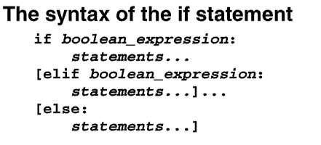
Decision Structures
Implementing the Decision Structures
Python syntax
Notice the following:
In python, we use elif instead of else if in the pseudocode.
Indentation must be respected ! Otherwise python interpreter complains with syntax errors.
The ( : ) at the end of the if , elif and else statements !
No End If at the end of the structure.

Slide 27
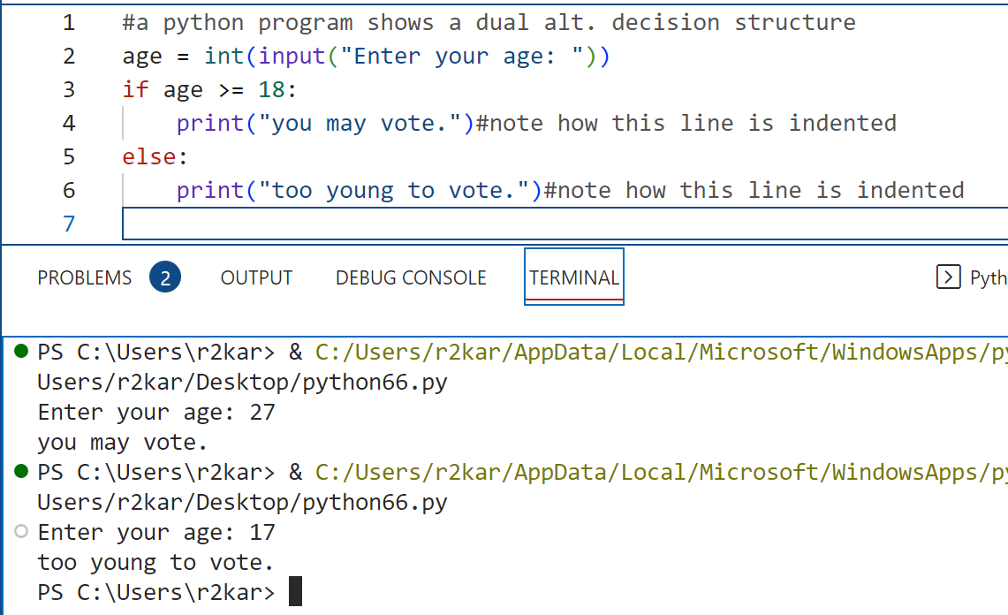
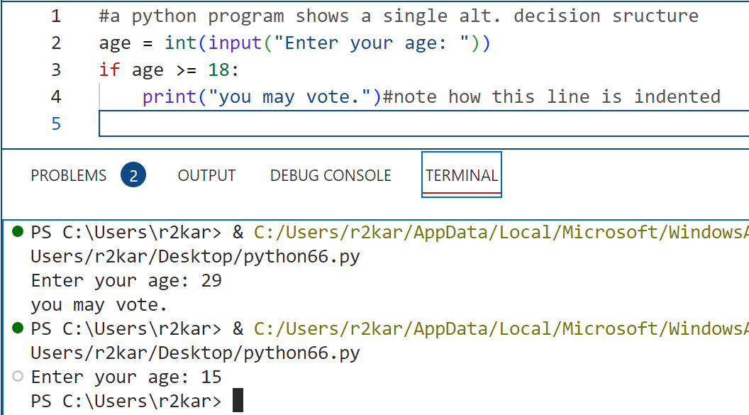
Decision Structures
Implementing the Decision Structures: examples

Slide 28
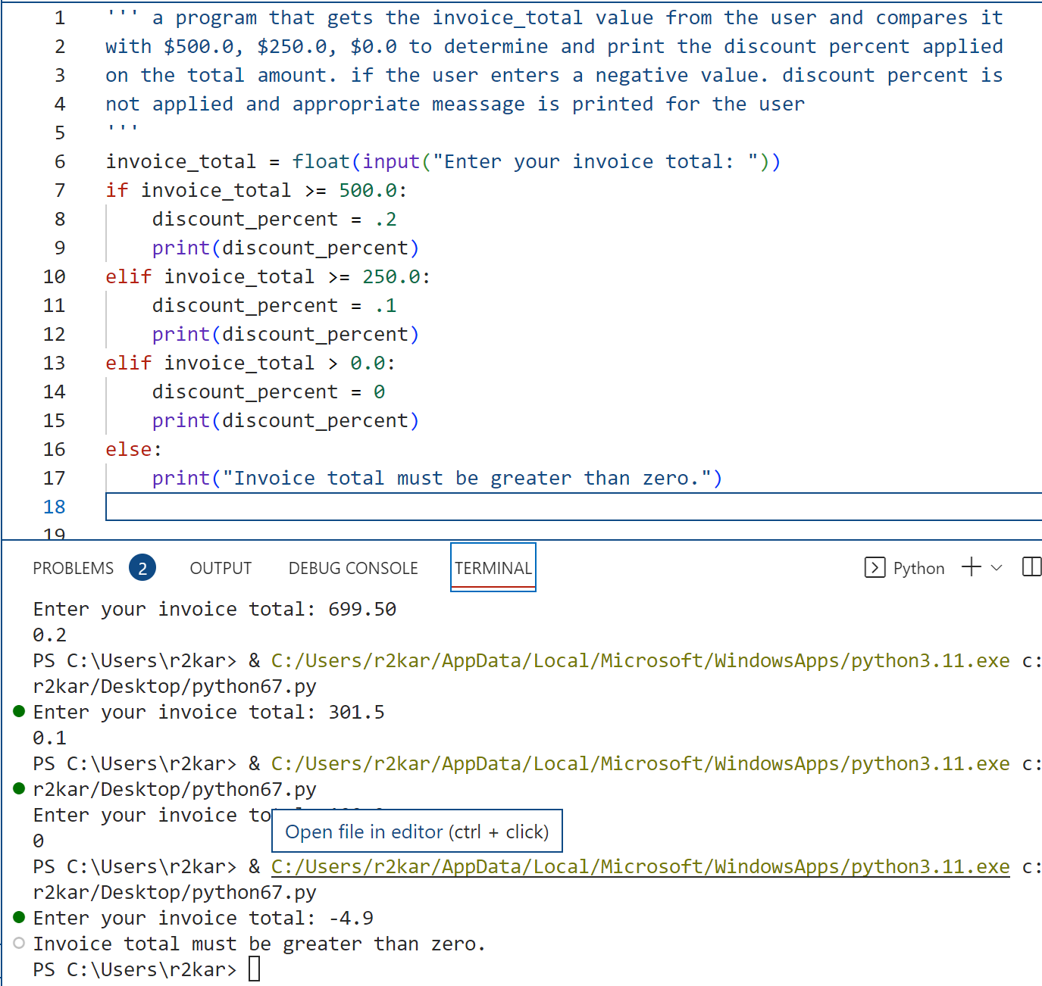
Decision Structures
Implementing the Decision Structures: examples

Slide 29
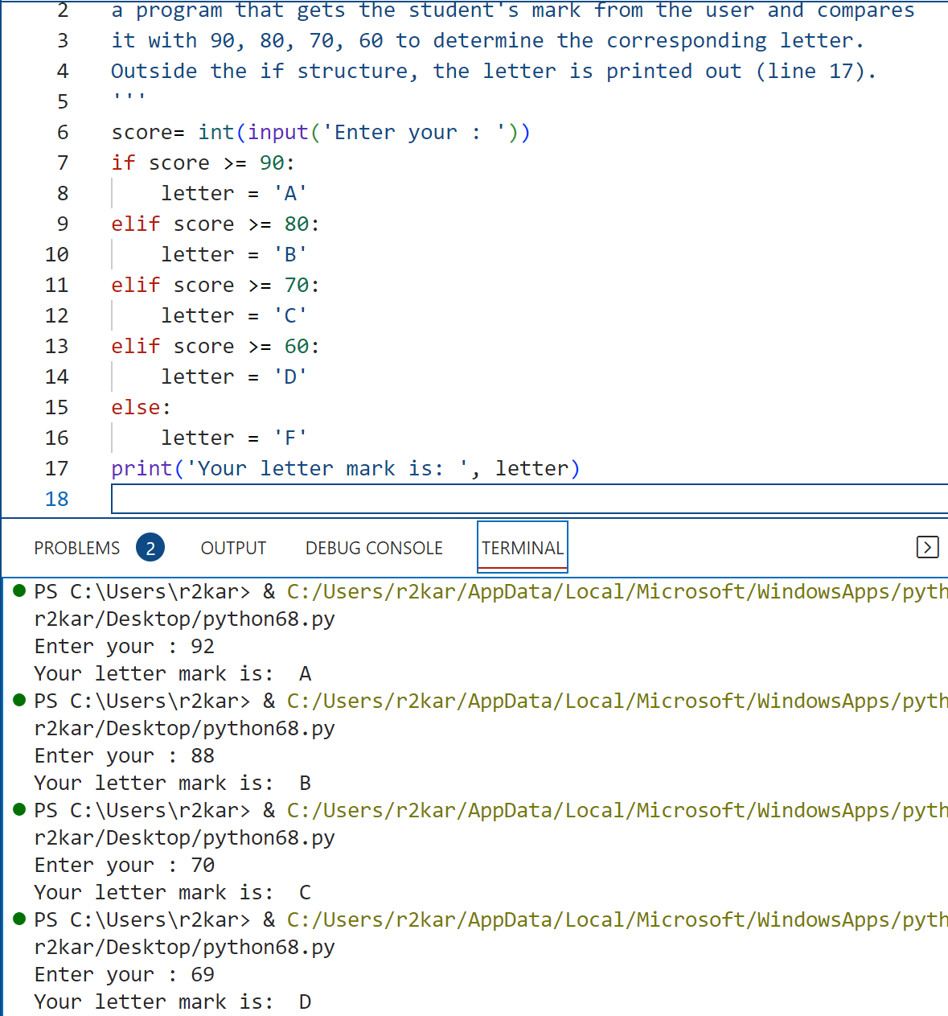
Decision Structures
Implementing the Decision Structures: examples

Slide 30
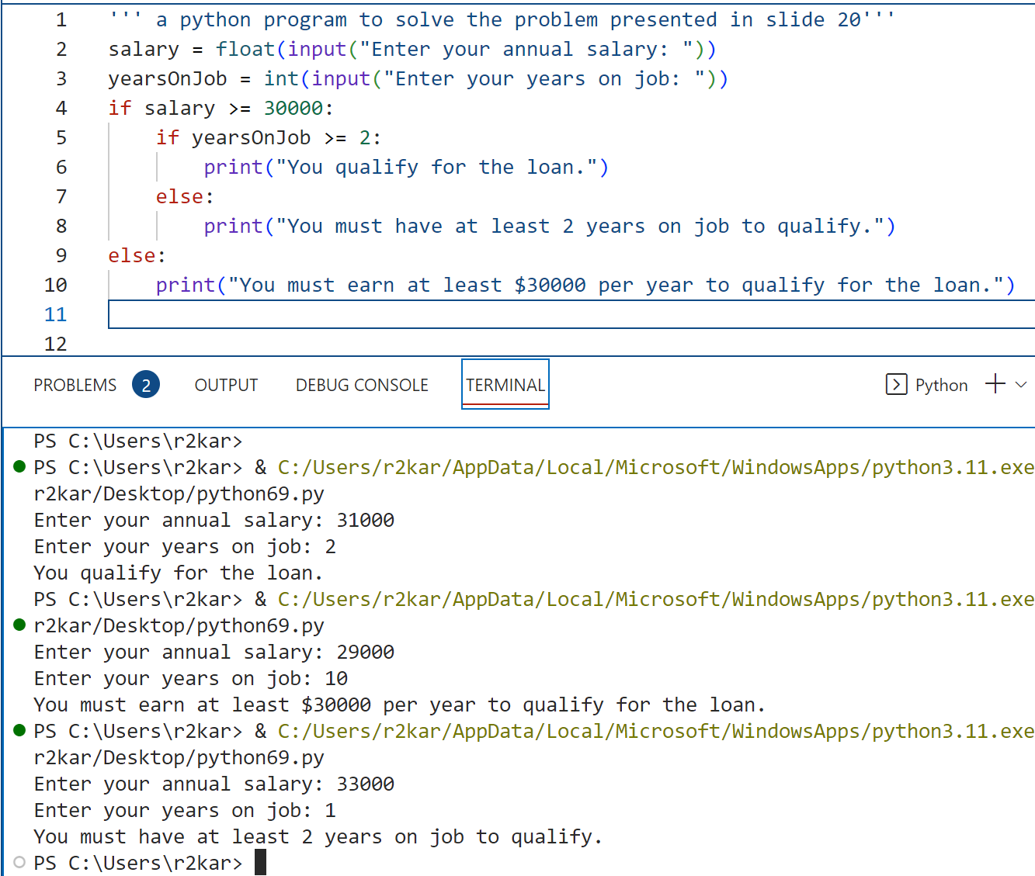
Decision Structures
Implementing the Decision Structures: examples

Slide 31
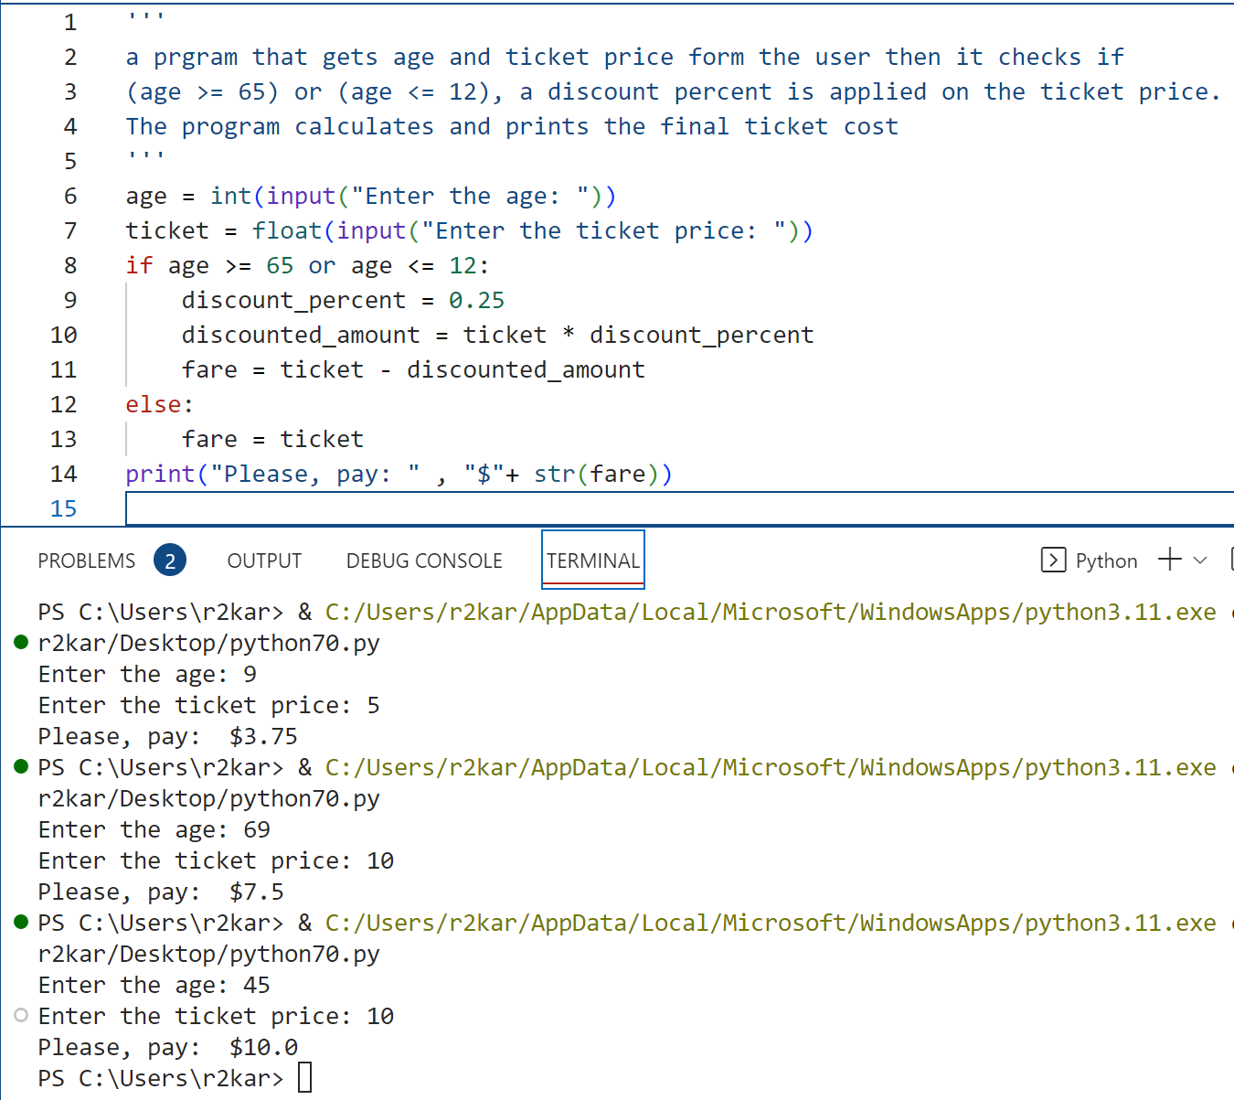
Decision Structures
Implementing the Decision Structures: examples

Slide 32
Decision Structures
Implementing the Decision Structures
Checking Numeric Ranges with Logical Operators
Sometimes you will need to design an algorithm that determines whether a numeric value is within a specific range of values or outside a specific range of values. When determining whether a number is inside a range, it is best to usethe and operator.
For example, the following if statement checks the value in x to determine whether it is in the range of 20 through 40:
if x >= 20 and x<=40:
print(“ the value is withing the acceptable range”)

Slide 33
Decision Structures
Implementing the Decision Structures
Checking Numeric Ranges with Logical Operators
The compound Boolean expression being tested by this statement will be true only when is greater than or equal to 20 and less than or equal to 40.

Slide 34
Decision Structures
Implementing the Decision Structures
Checking Numeric Ranges with Logical Operators
When determining whether a number is outside a range, it is best to use the or operator. The following statement determines whether x is outside the range of 20 through 40:.
if x < 20 or x > 40:
print(“ the value is outside the acceptable range”)

Slide 35
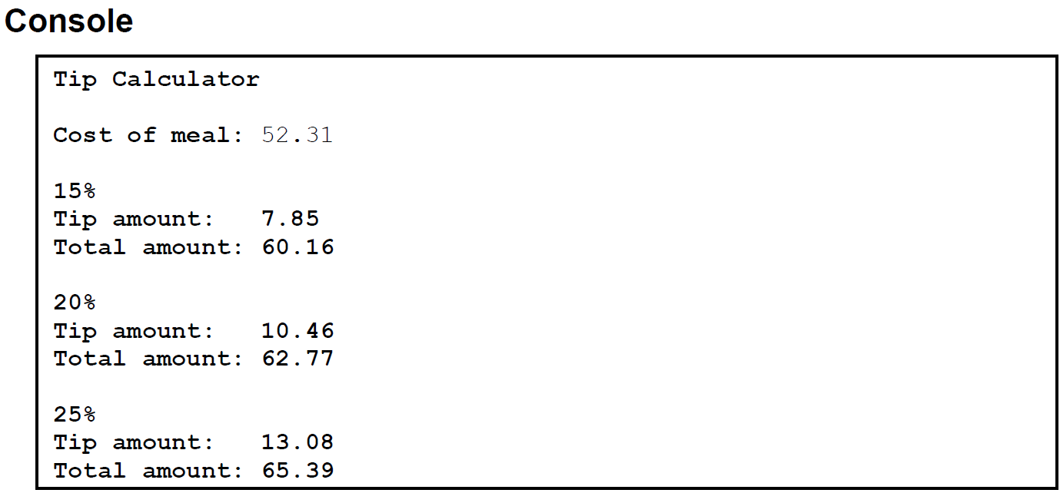
Decision Structures
Decision Structures implementation Exercise: Do it yourself !
1. Tip Calculator:
Create a program that calculates three options for an appropriate tip to leave after a meal at a restaurant.
Specifications
The program should calculate and display the cost of tipping at 15%, 20%, or 25%.
Assume the user will enter valid data.
The program should round results to a maximum of two decimal places.

Slide 36
Decision Structures
Decision Structures implementation Exercise: Do it yourself !
2. Shipping Calculator
Create a program that calculates the total cost of an order including shipping.
Use the following table to calculate shipping cost:
COST OF ITEMS SHIPPING COST
============= ==============
< 30.00 5.95
30.00-49.99 7.95
50.00-74.99 9.95
>= 75.00 FREE
After entering the cost of items, your program validates the user input (the cost value) so only values that are greater than 0 should be accepted and processed; otherwise, no processing can occur and the program displays an error message for the user. Hint: use this if statement after the input statement:
if cost_of_items > 0:

Slide 37
Decision Structures
Decision Structures implementation Exercise: Do it yourself !
2. User name and password
Create a program that prompts the user to enter the user name and password (e.g., raedk1, user123).
The program checks for the user name and password entered by the user, if they match predetermined values (e.g., raedk1, user123).
If they match, the program displays a message “You’re logged in!”; otherwise, it displays “Incorrect information.”
Last, the program dispalys a message “Thanks for using my program!”.
*prompts: it’s a professional keyword programmers use to mean “asks”. As a programmer you should get used to use professional/technical terminology ☺

Slide 38
Learning Python Turtle Module Part - 3

Slide 39
Turtle Module
Introduction to Turtle Module
A Python Module is a library of programming solutions for specific tasks.
The turtle graphics library provides numerous functions that you can use in decision structures to determine the state of the turtle and conditionally perform actions.
For example, there is a math module that contains all functions pertaining to math functions only.
For example, the Turtle module contains functions to draw graphics.

Slide 40
Turtle Module
Introduction to Turtle Module
There are many modules in Python.
The advantage of modules is that instead of writing code from scratch all the time, a module can be called to solve a particular problem.
This is the concept of software re-utilization.
There is no need to invent the wheel every time, if the wheel exists already, then just use it.

Slide 41
Turtle Module
Introduction to Turtle Module
The Python Turtle Module is used to draw.
A “turtle” leaves a trail as it moves.
By directing the direction of the movement, lines or shapes can be obtained.
Turtle Graphics is a fun way to introduces several concepts in Python programming, from basics to complex drawings.

Slide 42
Turtle Module
Introduction to Turtle Module
First, call the module (import turtle)
After the module is imported into Python IDLE, the Python Objects of the Turtle module are available to be used.
An Object has:
Methods: like movement actions (forward, backward, right, left)
Attributes: like colour, shape, position, width, speed.
Attributes:
Colour blue
Width = base x height
Object screen

Slide 43
Turtle Module
Introduction to Turtle Module
What do we need to make a drawing?
We need a canvas to draw, a screen. So we need to call a method that provides such screen.
We need to specify (or customize) the looks of the screen. So we need to modify the attributes to do that.
How do we make the drawing?
We need something that makes the drawings. So, we need to call the method to create the “turtles”.
We need to move them in the direction and distance that we want. So, we need to supply the attributes to do that.

Slide 44
Turtle Module
Introduction to Turtle Module
What do we need to make a drawing?
Make the screen. Give it a name.
Make the screen, call the method that makes screens.
Customize it, if you want.
How do we make the drawing?
Make the turtle. Give it a name.
Call the method that makes turtles.
Customize it, if you want.

Slide 45
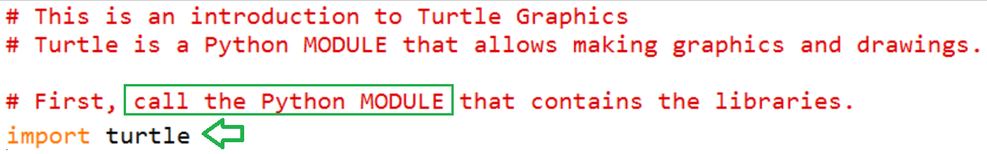
Turtle Module
Introduction to Turtle Module

Slide 46
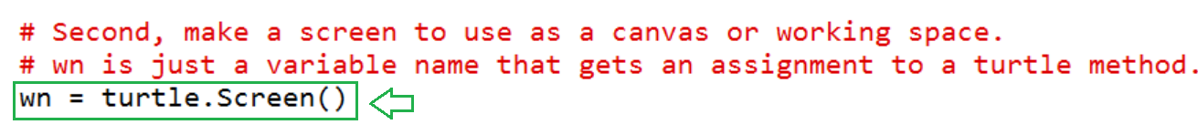
Turtle Module
Introduction to Turtle Module

Slide 47
Turtle Module
Introduction to Turtle Module

Slide 48
Turtle Module
Introduction to Turtle Module

Slide 49
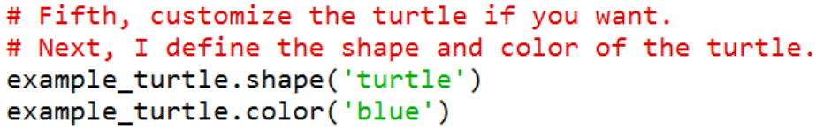
Turtle Module
Introduction to Turtle Module

Slide 50
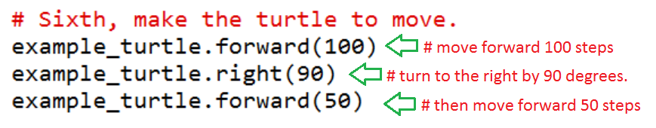
Turtle Module
Introduction to Turtle Module

Slide 51
Turtle Module
Introduction to Turtle Module

Slide 52
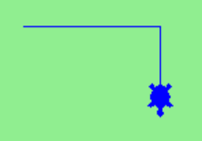
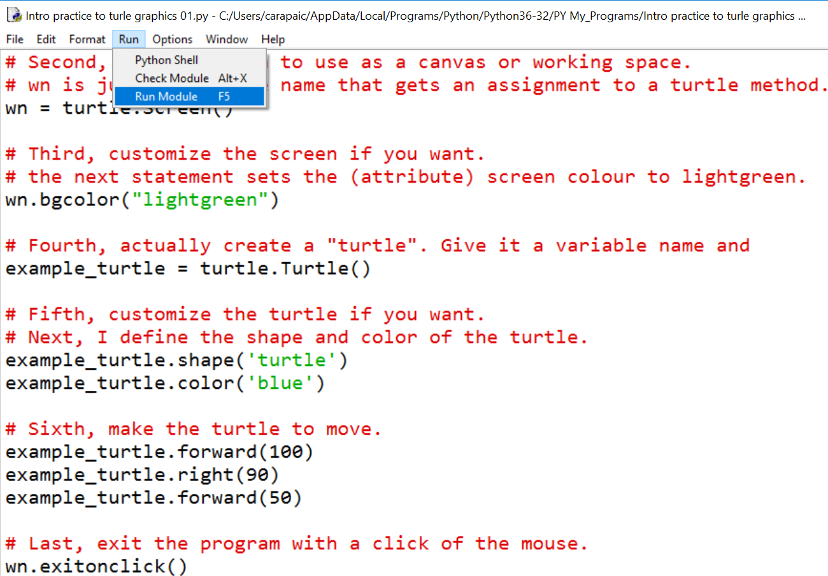
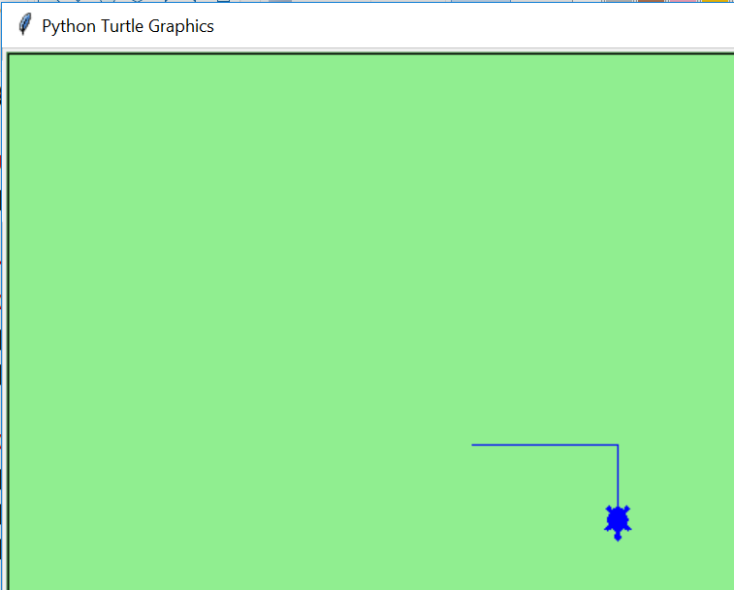
Turtle Module
Introduction to Turtle Module
Result

Slide 53
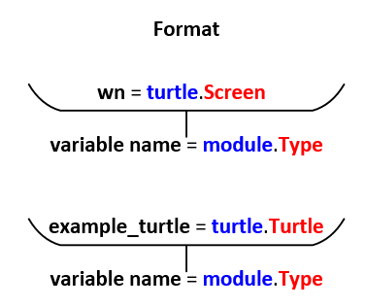
Turtle Module
Introduction to Turtle Module
import turtle means: “tell Python to load the module named turtle”.
Such module contains, among other things, two types: the screen type and the turtle type.
turtle.Turtle means: “Python, use the turtle type as defined in the turtle module.
Python is case sensitive, the module name is turtle and the type name is Turtle.

Slide 54
Turtle Module
Introduction to Turtle Module
Call the module library (import the_name_of_the_module)
Create a working space (canvas or screen wn = turtle.Screen()
Create a turtle. (example = turtle.Turtle()
Instruct it to move. (The object is moved by invoking the methods)
The dot symbol means “referred to”, for example:
something.method

Slide 55
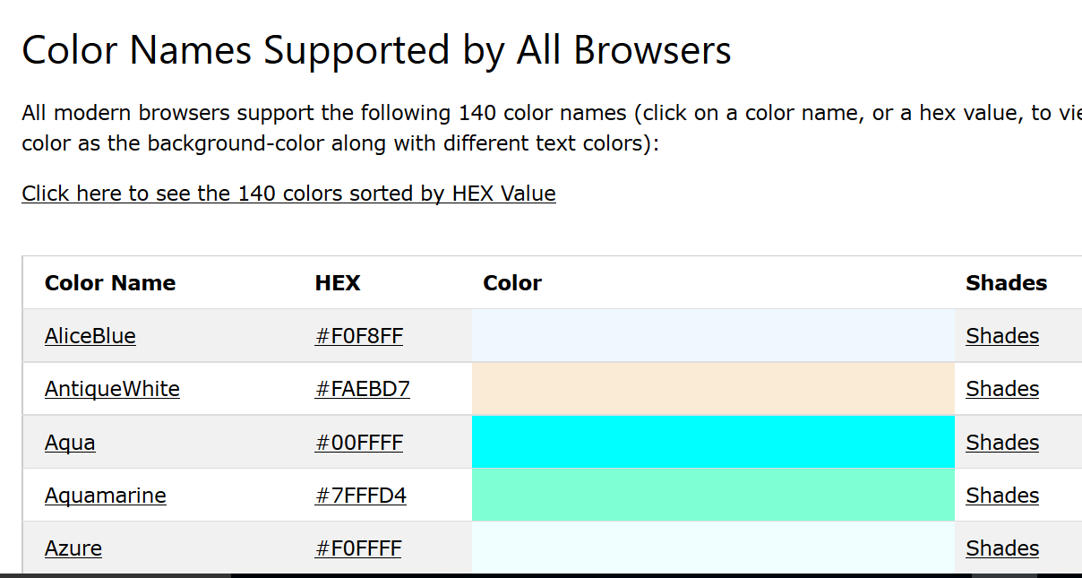
Turtle Module
Introduction to Turtle Module
The table at: www.w3schools.com/colors/colors_names.asp contains all the colour definitions supported by all browsers.

Slide 56
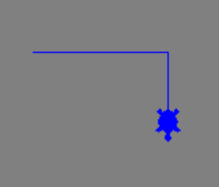
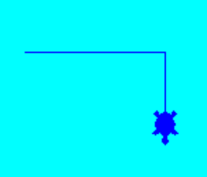
Turtle Module
Introduction to Turtle Module
The table at: www.w3schools.com/colors/colors_names.asp contains all the colour definitions supported by all browsers.
Colours can be called by names or numbers (hex), for example:
Grey is 808080
Black is 000000
Blue is 0000FF
Ghost white is F8F8FF
screen_name.bgcolor(‘grey’)
screen_name.bgcolor(‘aqua’)

Slide 57
Turtle Module
Introduction to Turtle Module
Each turtle is an independent object or instance of the turtle type (belonging to a class).
Each instance has its own attributes and methods.
We will talk more later about classes, objects, attributes and methods.

Slide 58
Turtle Module
Turtle Exercise: Do it yourself!
Make two turtles: blue and red.
Concept: each turtle is an independent object or instance of the turtle type (belonging to a class).
One turtle draws a square.
The other turtle draws a bigger square.
Concept: each instance has its own attributes and methods.

Slide 59
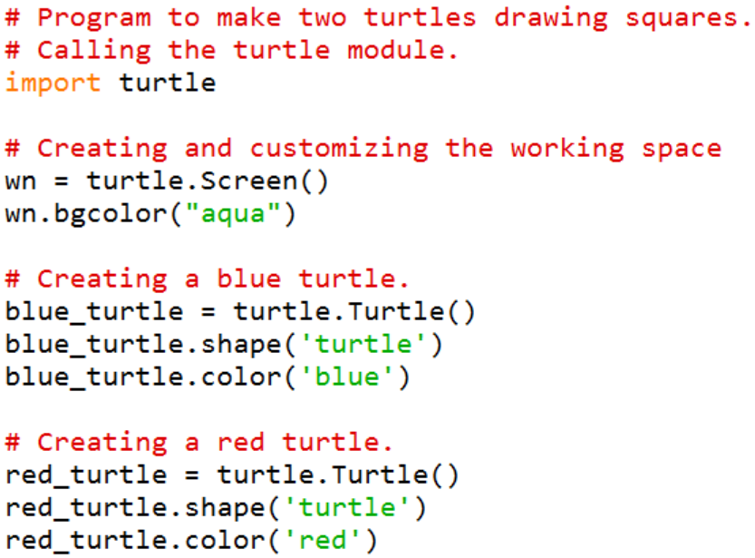
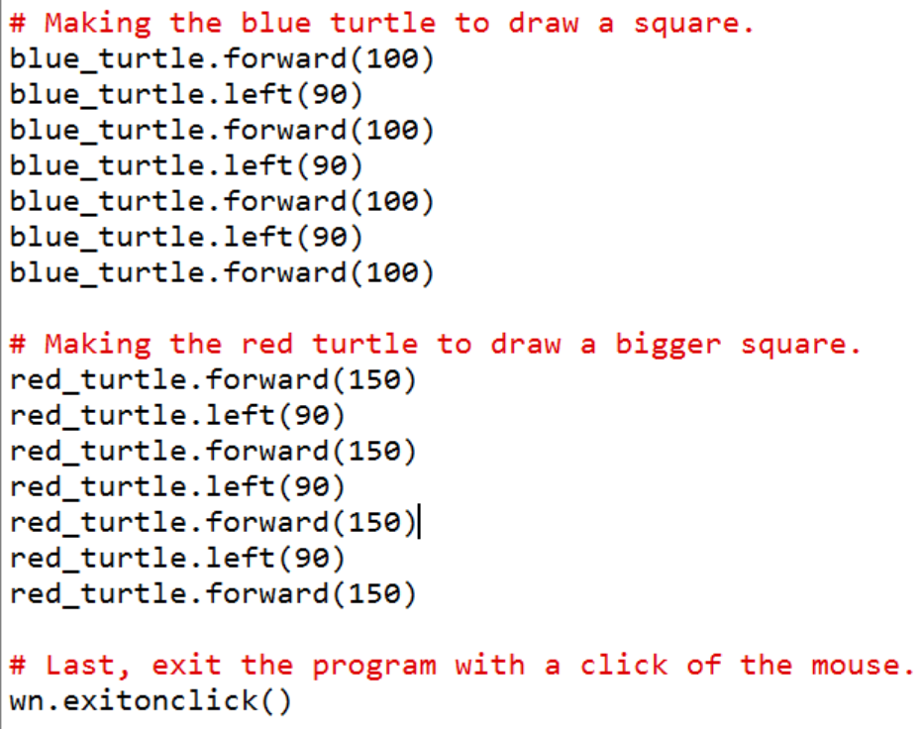
Turtle Module

Slide 60
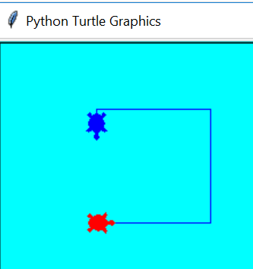
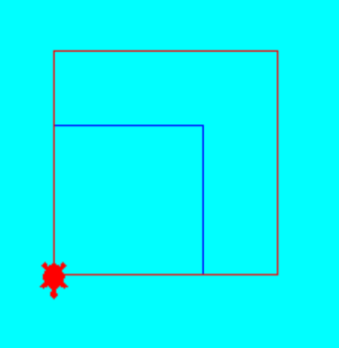
Turtle Module
Red turtle executes next.
Just as in the order written in the program.
Blue turtle executes first.

Slide 61
Determining Turtle state Part - 4

Slide 62
Turtle Module
Introduction to Turtle Module
You can use the turtle.xcor() and turtle.ycor() functions to get the turtle’s current X and Y coordinates.
The following code snippet uses an if statement to determine whether the turtle’s X coordinate is greater than 249, or the turtle’s Y coordinate is greater than 349. If so, the turtle is repositioned at (0, 0):
if turtle.xcor() > 249 or turtle.ycor() > 349 :
turtle.goto(0,0)

Slide 63
Turtle Module
Introduction to Turtle Module
The turtle.heading() function returns the turtle’s heading. By default, the heading is returned in degrees.
try: turtle.heading()
The following code snippet uses an if statement to determine whether the turtle’s heading is between 90 degrees and 270 degrees. If so, the turtle’s heading is set (using setheading() to 180.
If turtle.heading() >= 90 and turtle.heading()<= 270:
turtle.setheading(180)

Slide 64
Turtle Module
Introduction to Turtle Module
In Python, you can use the command to raise the pen, and the command to lower the pen. When the pen is up, you can move the turtle without drawing a line. When the pen is down, the turtle leaves a line when it is moved. (By default, the pen is down.)
When you execute the function turtle.pencolor()without passing it an argument, the function returns the pen’s current drawing color as a string.
turtle.pencolor() # it returns the current color
The following code snippet uses an if statement to determine whether the pen’s current color is red. If the color is red, the code changes it to blue:
If turtle.pencolor() == ‘red’:
turtle.pencolor(‘blue’)

Slide 65
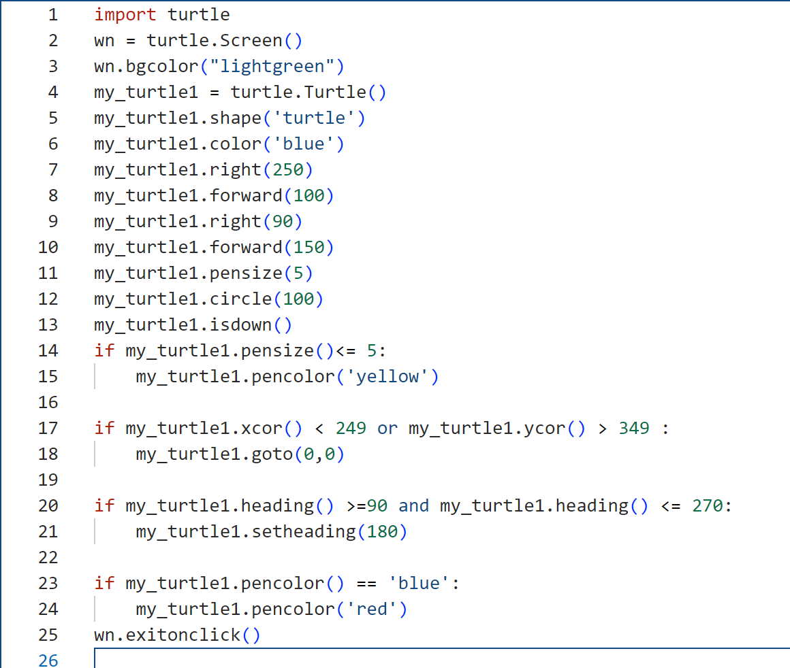
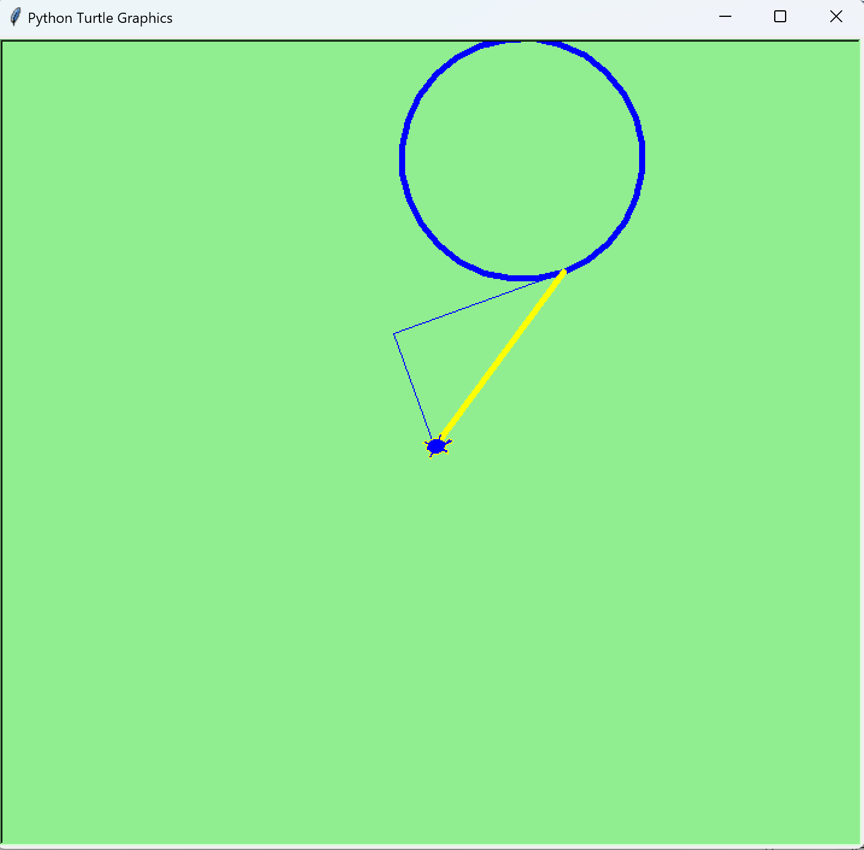
Turtle Module
Introduction to Turtle Module

Slide 66
Testing and Debugging Part - 5

Slide 67
Testing and Debugging
When you test a program, you run it to make sure that it works correctly. As you test the program, you try every possible combination of input data and user actions to be certain that the program works in every case. In other words, the goal of testing is to make the program fail.
When you debug a program, you fix the errors (bugs) that you discover during testing. Each time you fix a bug, you test again to make sure that the change you made didn’t affect any other aspect of the program.

Slide 68
Testing and Debugging
The goal of testing :
To find all errors before the program is put into production.
The goal of debugging:
To fix all errors before the program is put into production
Common syntax errors:
Misspelling keywords.
Forgetting the colon at the end of the opening line of a function definition, if clause, else clause, while statement, for statement, try clause, or except clause.
Forgetting an opening or closing quotation mark or parenthesis.
Using parentheses when you should be using brackets, or vice versa.
Improper indentation.

Slide 69
Testing and Debugging
We knew from Week 2 that there are three types of errors might occur in a program.
Syntax errors prevent your program from compiling and running. Since syntax errors occur when Python attempts to compile a program, they’re known as compile-time errors. This type of error is the easiest to find and fix. When you use Visual Studio Code, it highlights the location of the first syntax error that it finds each time you attempt to run the program. Then, you can correct that error and try again.
Unfortunately, some errors can’t be detected until you run a program. These errors are known as runtime errors, and they throw exceptions that stop the execution of a program.
Even if a program runs without throwing exceptions, it may contain logic errors that prevent the program from working correctly. This type of error is often the most difficult to find and fix.

Slide 70
Testing and Debugging
Problems with names and values:
Misspelling or incorrectly capitalizing a variable or function name.
Using a keyword as a variable or function name.
Not checking that a value is the right data type before processing it. For example, using a number when it needs to be converted to a string, or vice versa.
Problem with floating-point arithmetic:
The float data type in Python uses floating-point numbers, and that can lead to arithmetic results that are imprecise. For example:
sales_amount = 74.95; discount = sales_amount * .1;
# result is 7.495000000000001
One quick way to fix this problem is to round the result to the right number of decimal places. If necessary, you can also convert it back to a floating-point number:
discount = round(discount, 2) # result is 7.5

Slide 71
Testing and Debugging
The two critical test phases:
Test the program with valid input data to make sure the results are correct.
Test the program with invalid data or unexpected user actions. Try everything you can think of to make the program fail.
How to make a test plan for the critical phases:
List the valid entries that you’re going to make and the correct results for each set of entries. Then, make sure that the results are correct when you test with these entries.
List the invalid entries that you’re going to make. These should include entries that test the limits of the allowable values.
Two common testing problems:
Not testing a wide enough range of entries.
Not knowing what the results of each set of entries should be and assuming that the answers are correct because they look correct.

Slide 72
Testing and Debugging
Tracing code execution
When you trace the execution of a program, you add statements to your code that display messages or variable values at key points in the code. You typically do this to help find the cause of a logic error. You can insert print() functions into the code to print values or displaying messages.

Slide 73
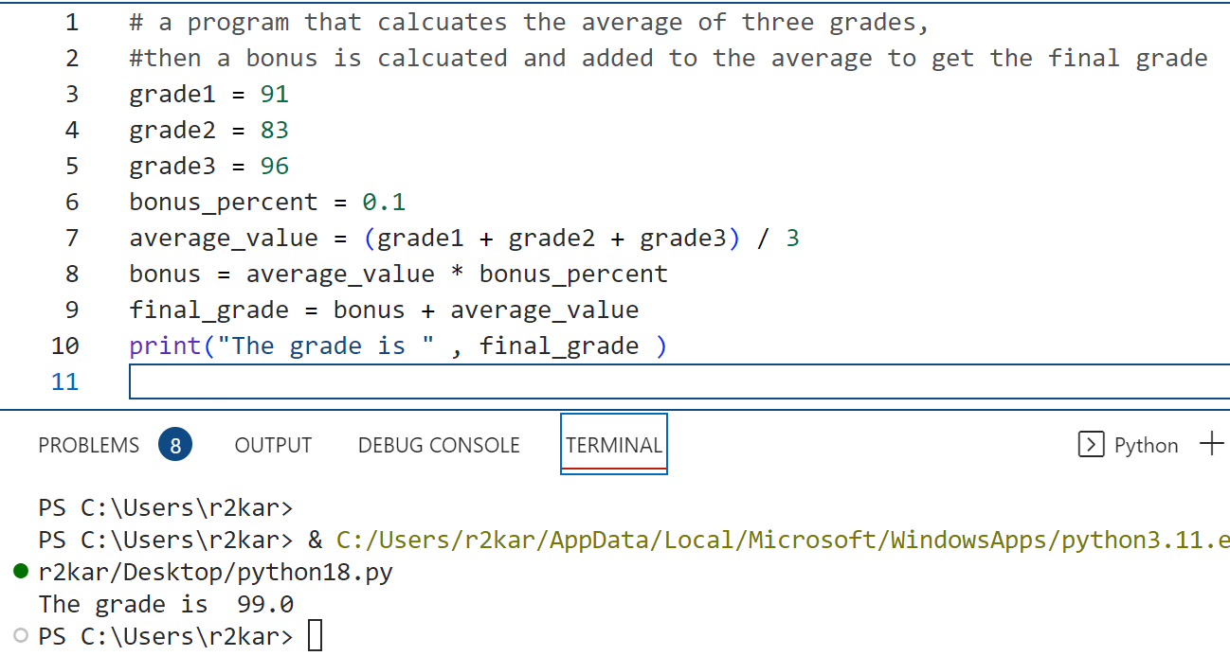
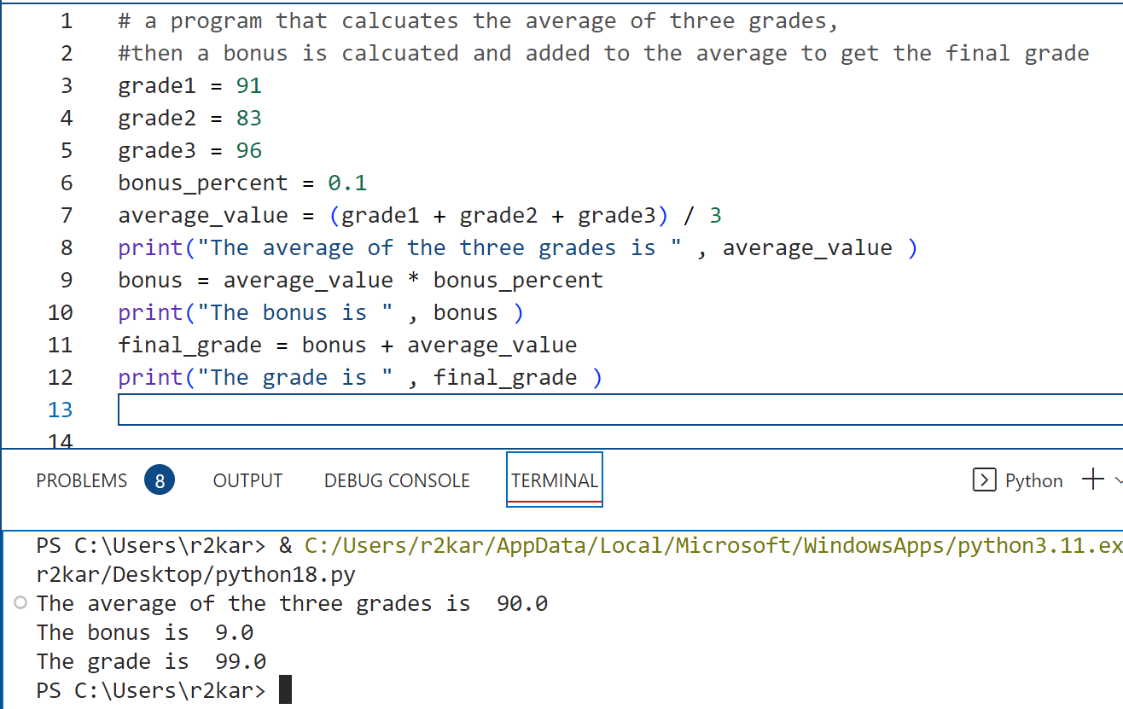
Testing and Debugging
Tracing code execution
The code on the right side contains two additional print statements (lines 8 and 10). They are added for code tracing purpose. The programmer can trace the values of bonus and the average_value to make sure they are correct.

Slide 74
Testing and Debugging
Top-down Testing
Another way to simplify debugging is to code and test just a small portion of a program at a time. This can be referred to as top-down testing.
Later in the course, you will learn about functions.
A function is that small portion of a program that performs a small and specific task of the entire program- (a program usually has multiple tasks to perform).
That tells us that a program can have multiple functions to solve a problem.

Slide 75
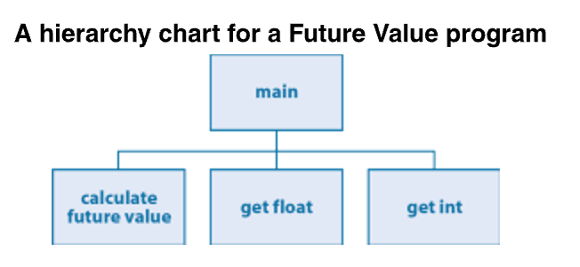
Testing and Debugging
Top-down Testing
When testing, a programmer or a tester usually test the functions independently starting from the main function down to the other functions in the program to make sure they work properly and produce the expected results. You can use the code tracing technique to test each function in your program.
In this way, we easily and efficiently test the entire program – by testing its functions independently.
Multiple testers can test multiple functions concurrently which is GREAT to save testing time!

Slide 76
Testing and Debugging
Using Debugger
So far in this chapter, you’ve learned the skills that you’ll use to solve most of your debugging problems. Occasionally, though, you’ll run into bugs that are difficult to isolate.
Most modern IDEs (like Visual Studio Code) include debuggers.
Breakpoints can be toggled by clicking on the editor margin or using F9 on the current line. Finer breakpoint control (enable/disable/reapply) can be done in the Run and Debug view's BREAKPOINTS section.
Breakpoints in the editor margin are normally shown as red filled circles.
Disabled breakpoints have a filled gray circle.
When a debugging session starts, breakpoints that cannot be registered with the debugger change to a gray hollow circle. The same might happen if the source is edited while a debug session without live-edit support is running.

Slide 77
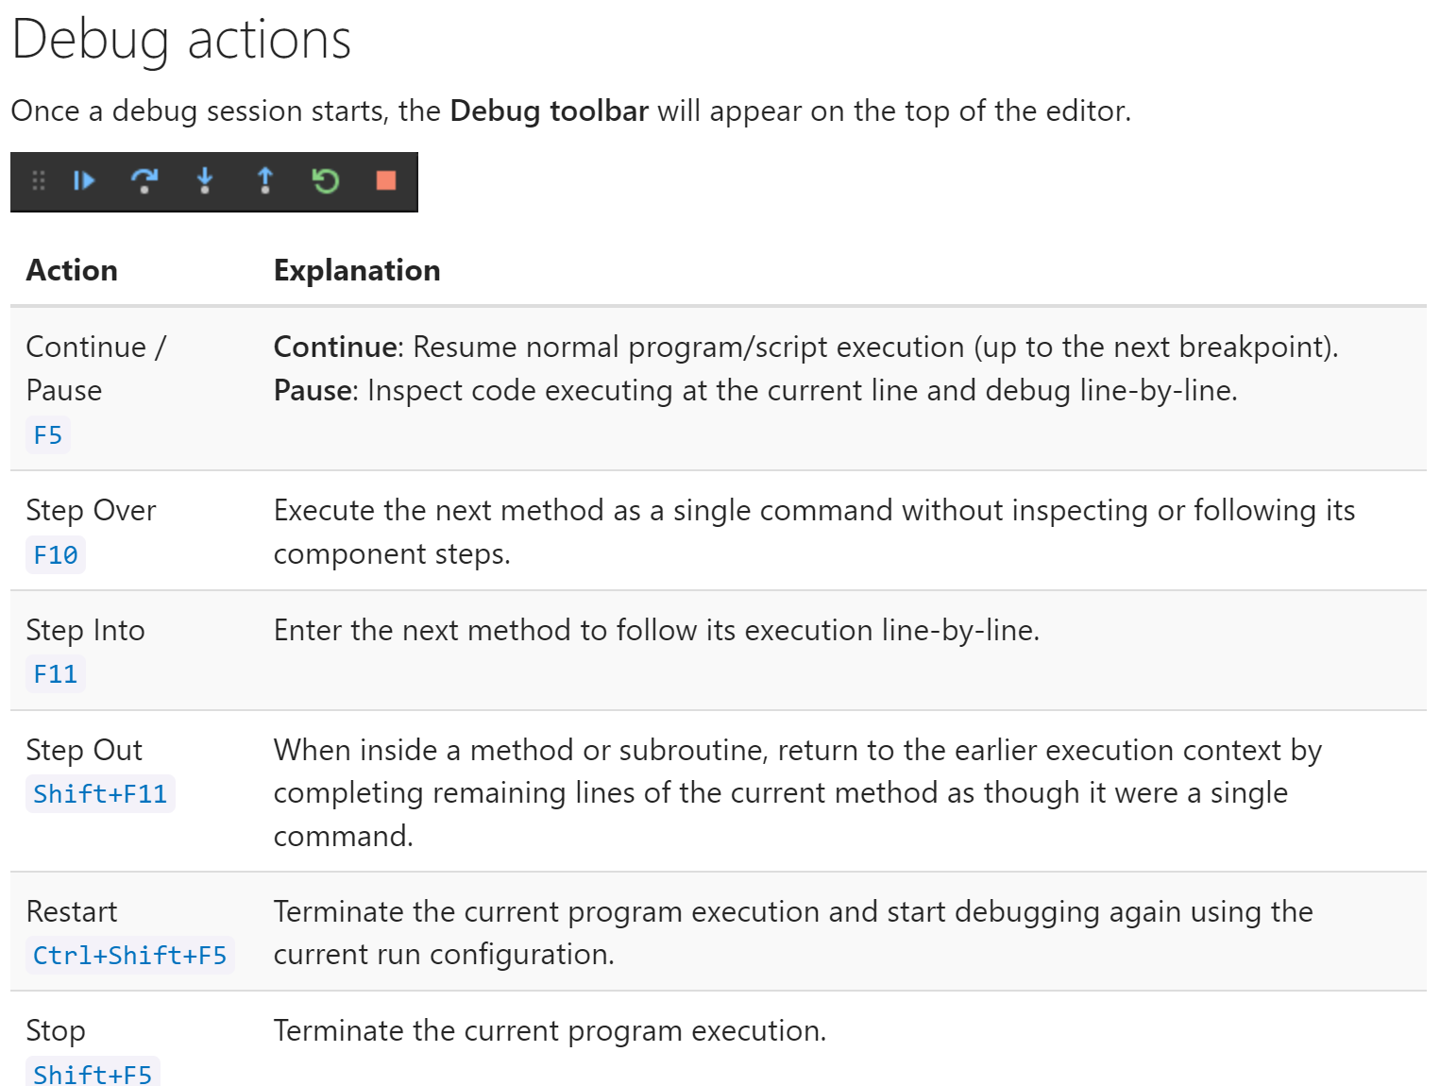
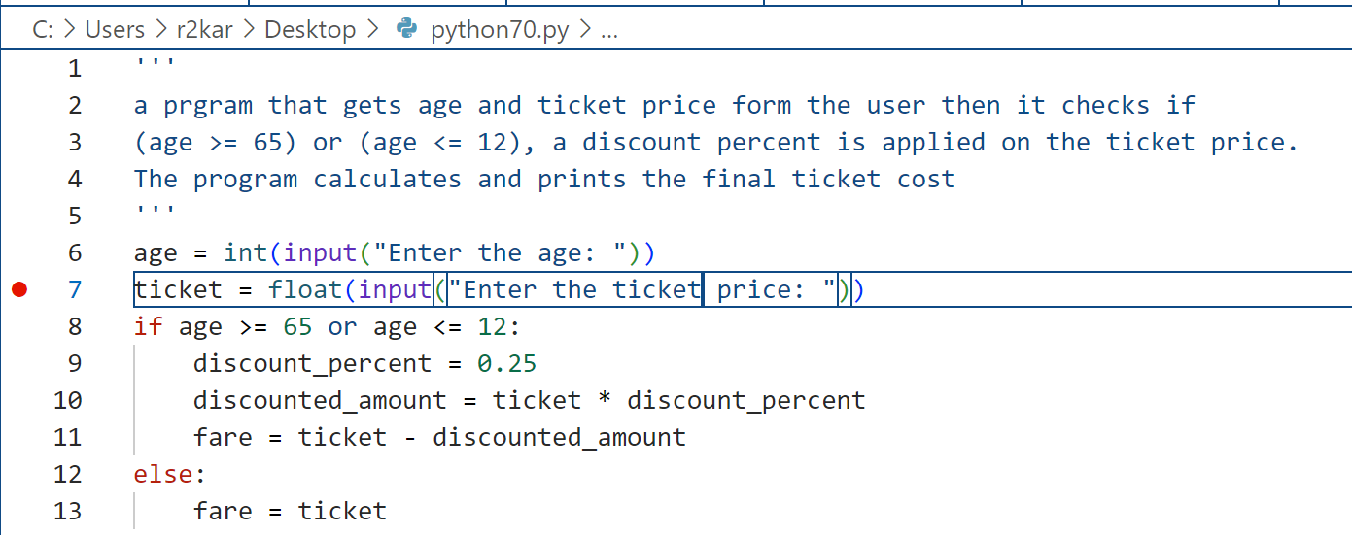
Testing and Debugging
Using Debugger
A breakpoint (select a line then press F9 on the keyboard to enable)

Slide 78
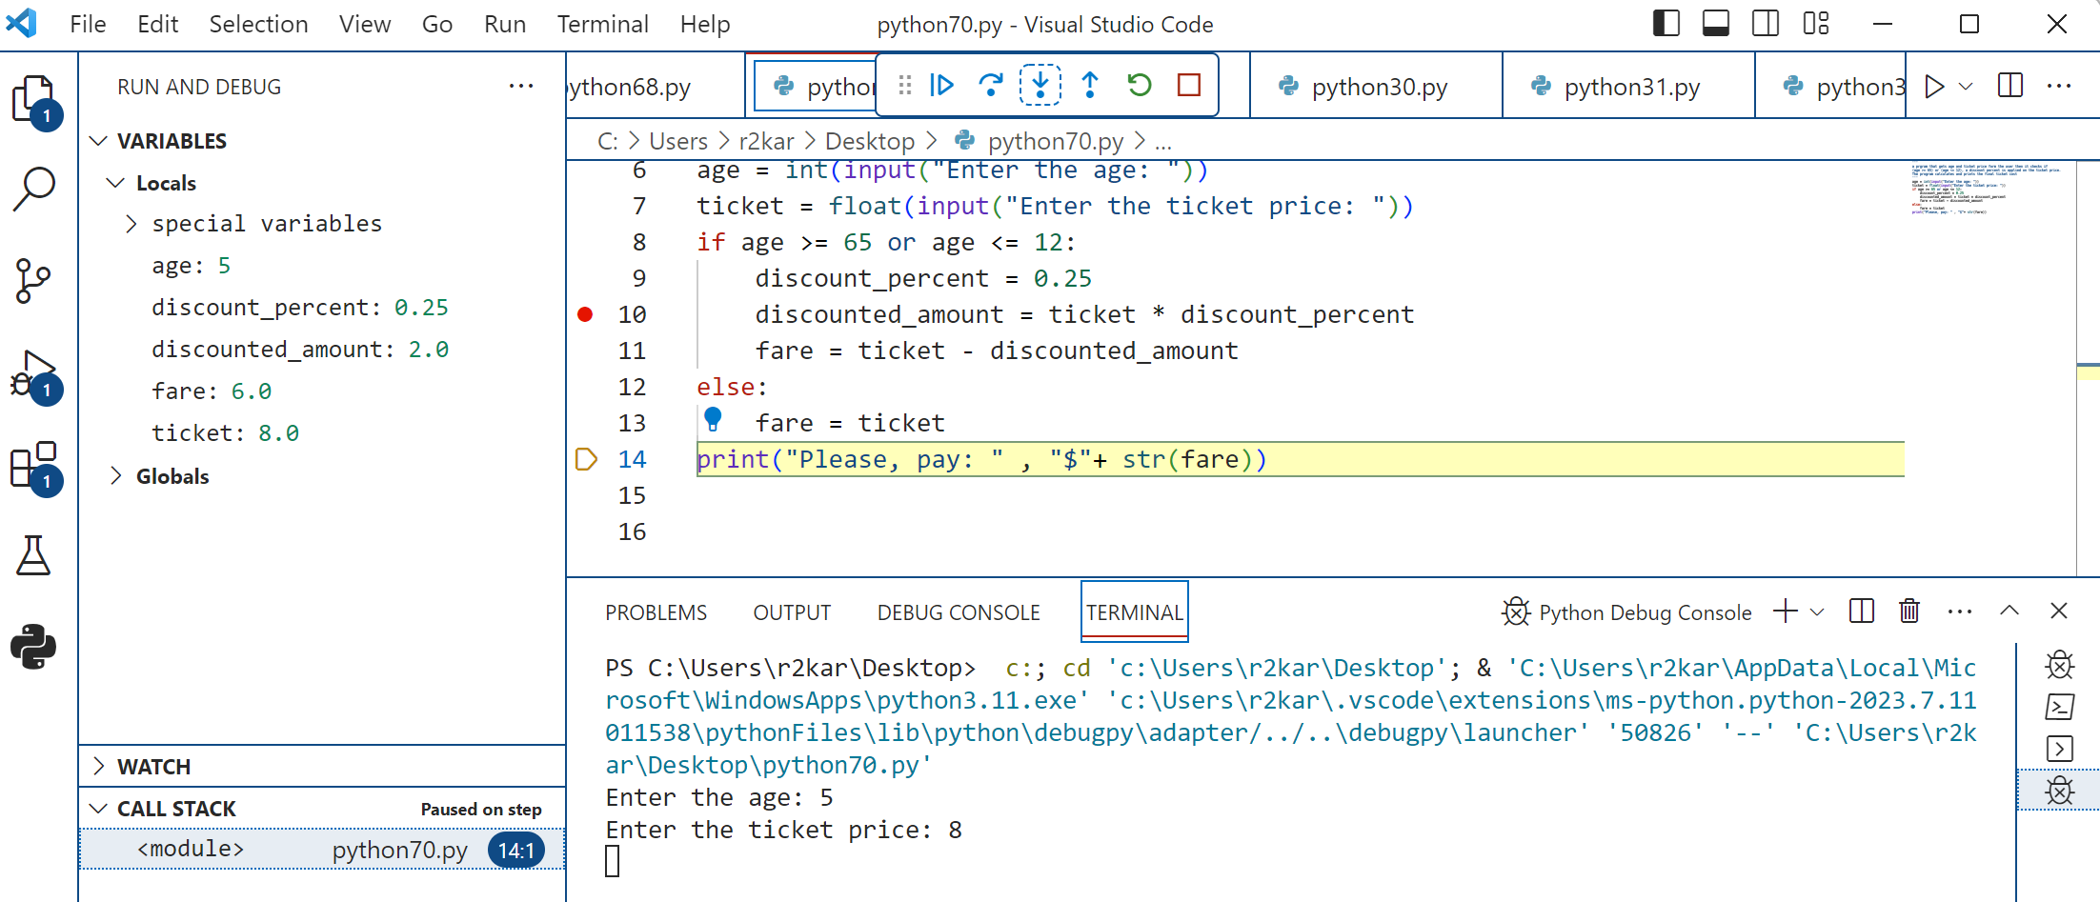
Testing and Debugging
Using Debugger
Debugger traces the variables
The debug toolbar
A breakpoint

Slide 79
Testing and Debugging
You can watch this short tutorial for debugging python programs in visual studio code:
https://www.youtube.com/watch?v=FT-IWVYJYug

Slide 80
Testing and Debugging
Debugger Exercise: Do it yourself !
Use the VS code debugger to debug the code shown in slide 27.
Do the following:
Set multiple breakpoints in the code.
Run and Debug
Step into, Step Over
Analyze the VARIABLES in the RUN AND DEBIG panel.

Slide 81
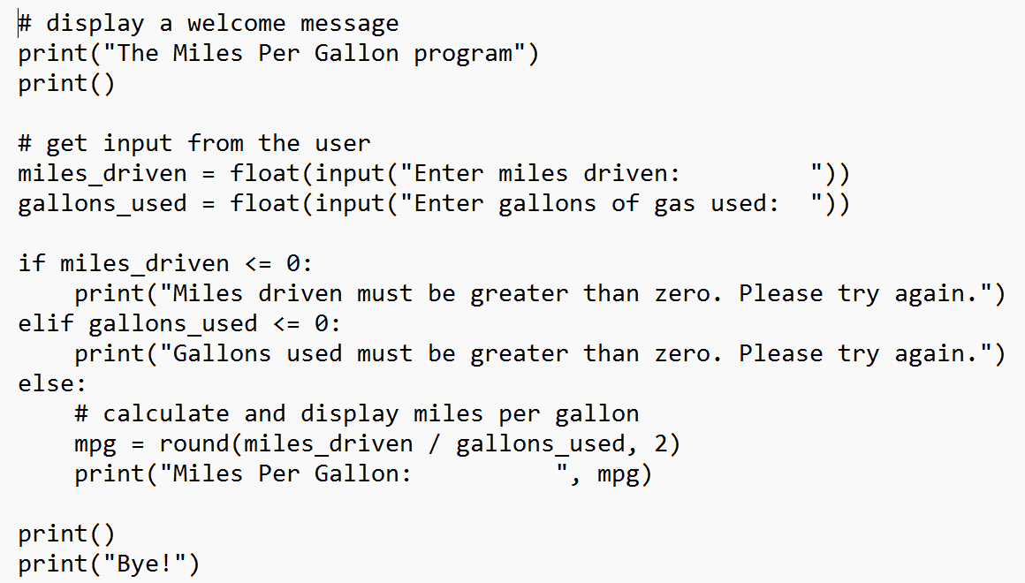
Testing and Debugging
Debugger Exercise: Do it yourself !
Review the code shown to the right side.
Trace the code by inserting multiple print() functions (one at a time) to display the values and to make sure they are correct (what you expect). If they are not, your task is to fix the errors.

Slide 82
References
Material has been taken from (can be accessed through Sheridan's Library Services) :
Starting Out with Python (ISBN-13: 9780136912330 ):
https://www.pearson.com/en-ca/subject-catalog/p/starting-out-with-python/P200000003356/9780136912330
Murach’s Python 2nd Edition programming, 2nd Edition :
https://bookshelf.vitalsource.com/reader/books/9781943872756/pages/recent
Introducing Python, Lubanovic, B., O'Reily Media, 2nd Edition, 2019
https://www.oreilly.com/library/view/introducing-python-2nd/9781492051374/

